Slide 1
Types of Game Platforms
&
Programming Languages
Subject Name: Platform Based Development
Subject Code: PBDV301 | PBDE401
Lecturer Name : Freedom
Department : Information Technology

Slide 2
Outline of the lesson
Objectives :
Develop a thorough understanding of the components and functions of a game platform.
Explore various types of game platforms, identifying their distinct features and use cases.
Acquire knowledge of programming languages commonly used in game development and understand their specific roles.
Gain insight into the entire game development lifecycle, including the use of game engines and the key roles involved in creating a game.

Slide 3
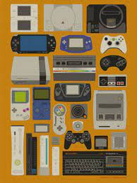
What is a game platform?
A game platform is the environment or system on which a video game runs. It includes both the hardware (device) and the software ecosystem (operating system, APIs, and tools).
The term "platform" refers to the underlying technology or infrastructure that supports the games and allows them to be played.
Why platform matters?
  Performance (graphics, speed)
  Controls (keyboard, controller, touch)
  Audience (casual vs hardcore gamers)
  Development complexity
Think: A game designed for a smartphone must be optimized differently than one for a high-end gaming PC

Slide 4
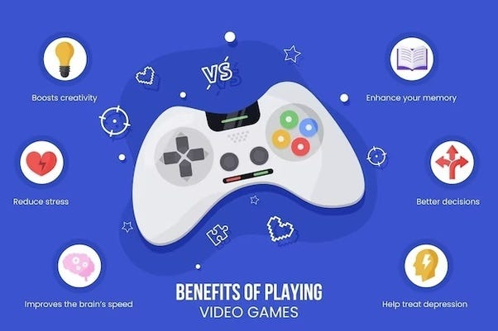
Benefits of Video Games
Improve Cognitive Skills
Enhance Coordination
Encourages Teamwork and Social Connections
Reduces Stress
Boost Creativity
Therapeutic Uses
Learning and Education

Slide 5
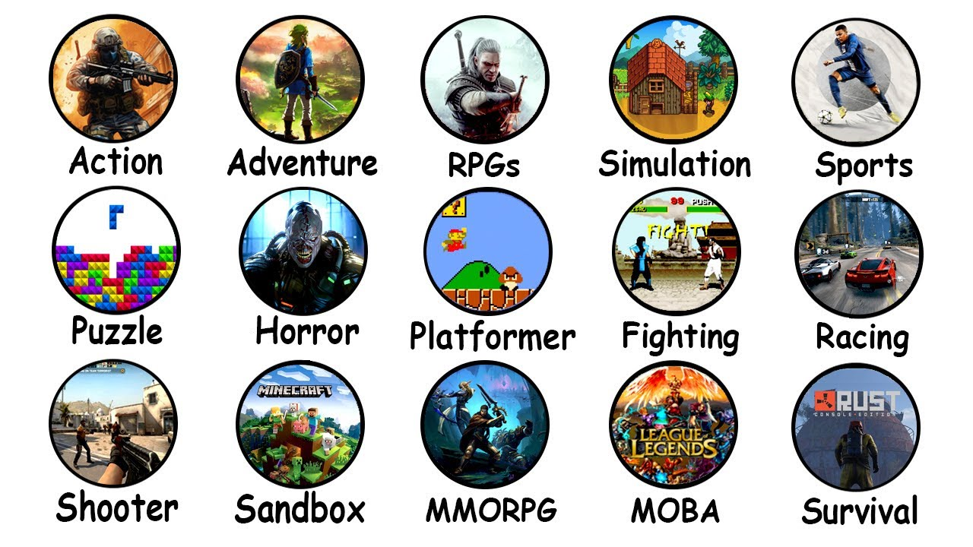
Types of Games
By Genre
  Action Games
  Adventure Games
  Role-Playing Games (RPGs)
  Simulation Games
  Strategy Games
  Sport Games
  Puzzle Games
By Player Mode
  Sing-Player
  Multiplayer
  Online Multiplayer (MMO)

Slide 6
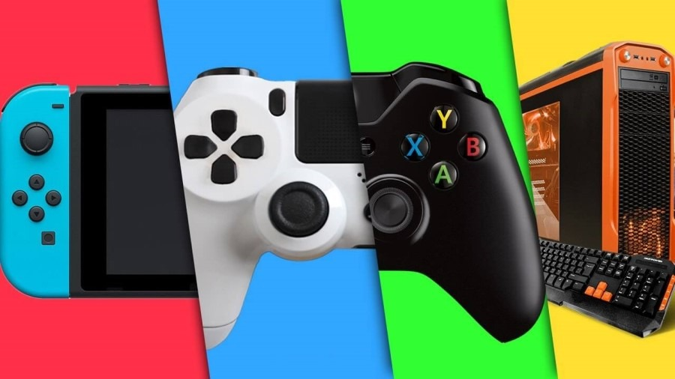
Types of Games Platforms
Determine how games are played
Shape game design
Affect accessibility
Influence cost and development
Define the gaming experience
Impact distribution and reach
Drive innovation
Types of Game Platforms
  • PC Platforms
  • Console Platforms
  • Mobile Platforms
  • Web-Based Platforms
  • Cloud Gaming Platforms
  • Virtual Reality Platforms

Slide 7
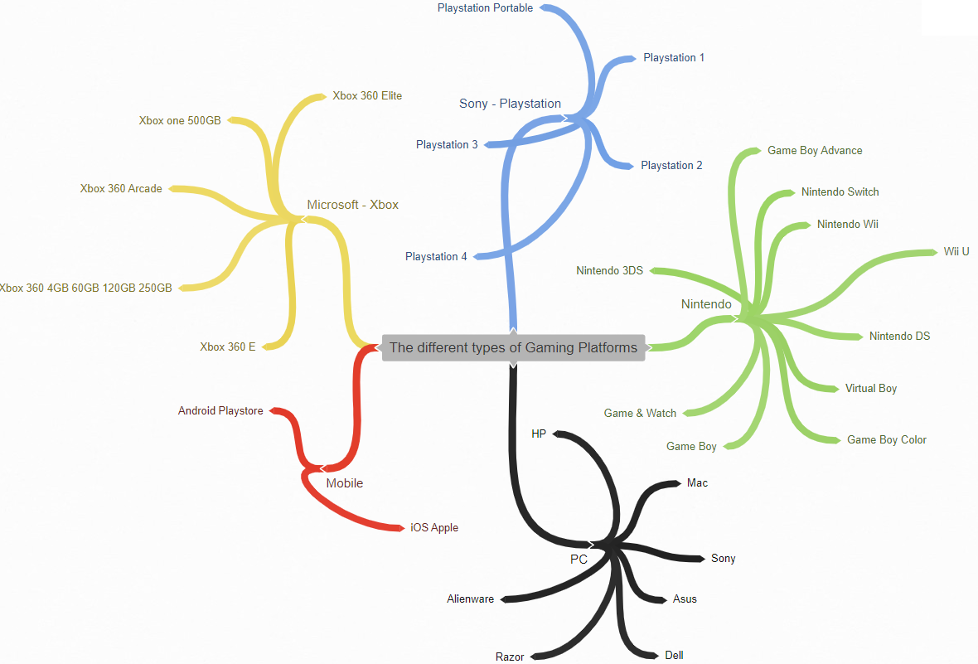
Types of Games Platforms

Slide 8
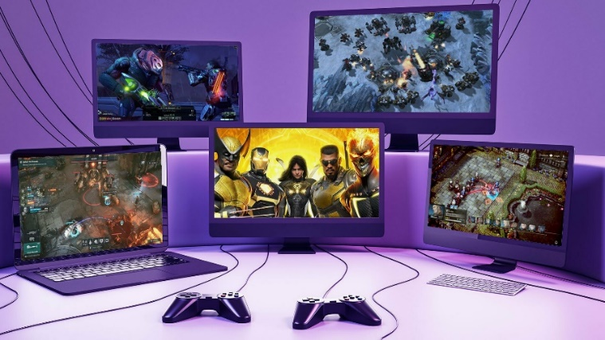
Types of game platforms
PC Platforms
PC platforms are gaming computers that offer a wide range of games and advanced features.
They are highly customizable and offer superior performance.
Support multiple game distribution platforms like Steam and Epic Games Store. Examples - Windows PC and Mac.

Slide 9
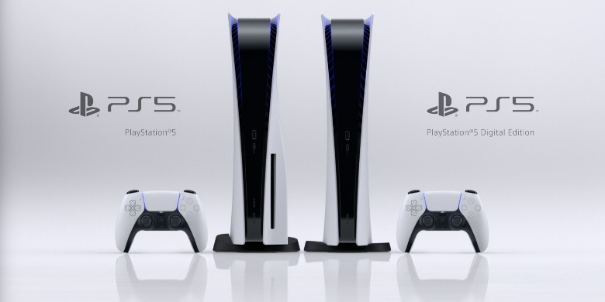
Types of game platforms
Console Platforms
Console platforms are dedicated gaming machines designed for home use.
They typically offer high-quality graphics, advanced features, and exclusive titles. Examples- Sony PlayStation, Microsoft Xbox and Nintendo Switch.

Slide 10
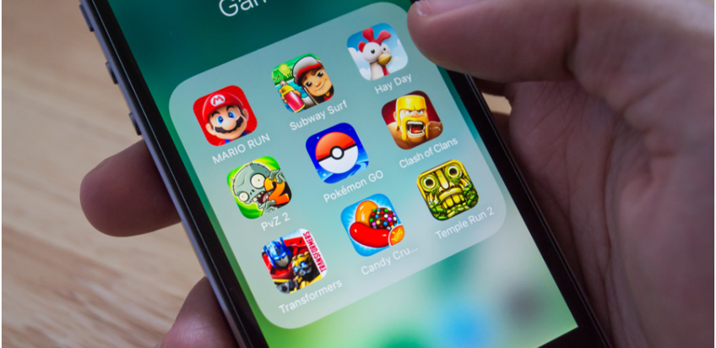
Types of game platforms
Mobile Platforms
Mobile platforms are used to play games on smartphones and tablets.
Often simpler mechanics, touch controls, and accessible to a broad audience.
They offer a wide range of games, including casual games and more complex titles. Examples : Android and iOS

Slide 11
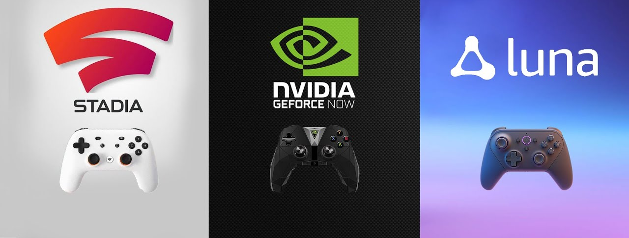
Types of game platforms
Cloud Gaming Platforms
Cloud gaming platforms are the latest addition to the gaming landscape.
They allow players to stream games over the internet, eliminating the need for dedicated hardware. Examples : Google Stadia and Nvidia GeForce Now

Slide 12
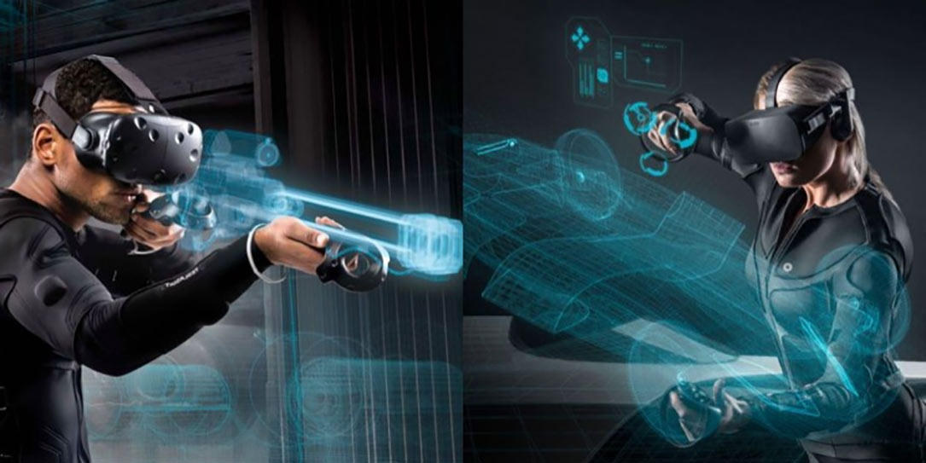
Types of game platforms
Virtual Reality Platforms
Virtual reality (VR) games generally require players to use a special head-mounted unit .
This unit provides stereoscopic screens and motion to immerse a player within virtual environment that responds to their head movements.

Slide 13
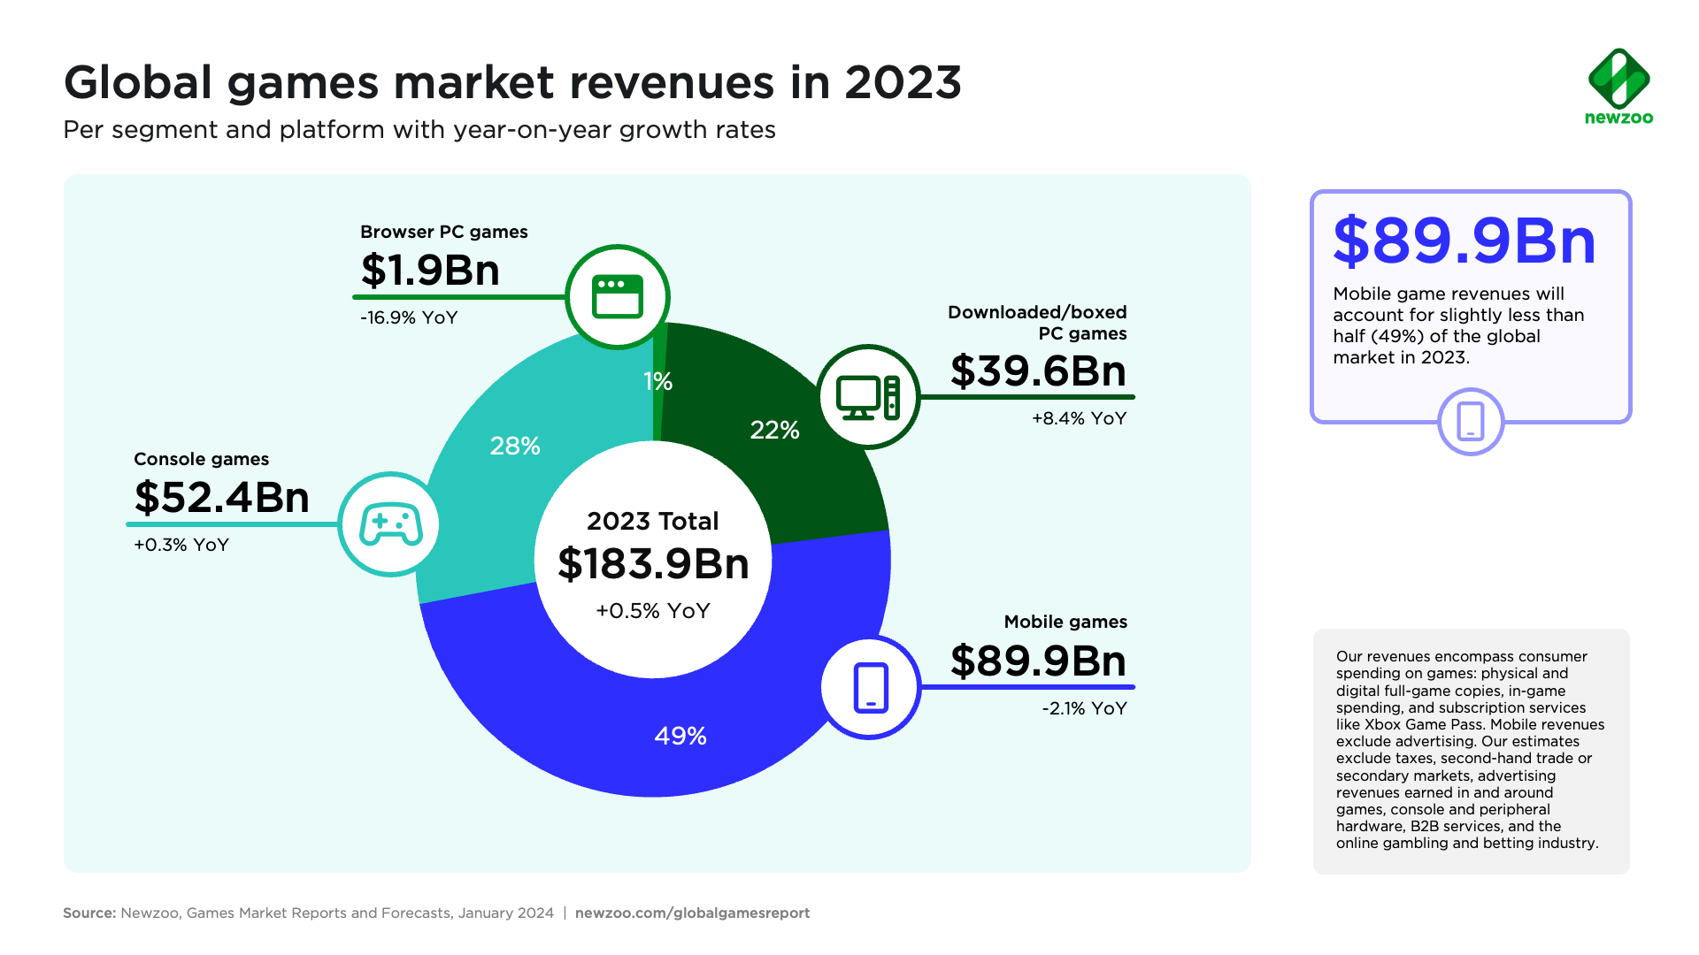
Global Game Market

Slide 14
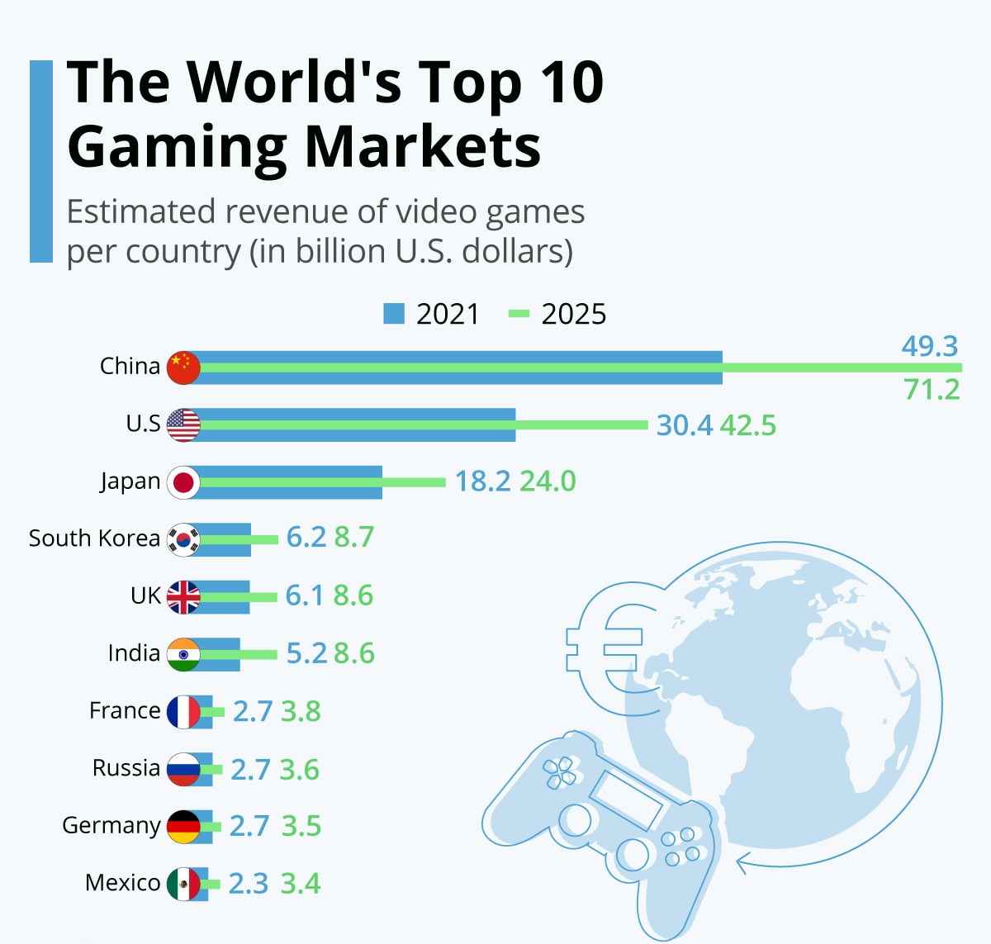

Slide 15

New Business
Stop playing around
Gaming is business
Mind your business

Slide 16
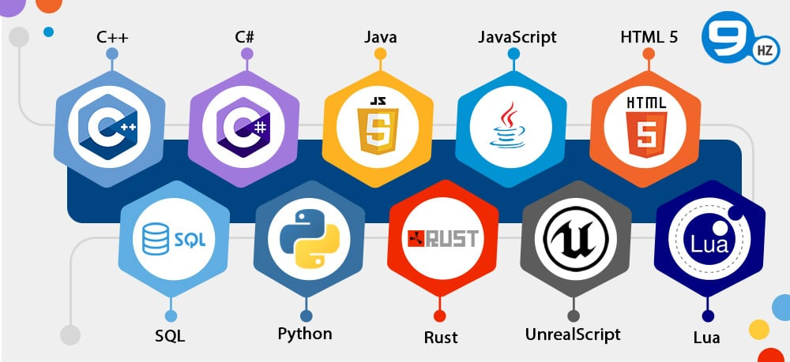
Game Programming Languages

Slide 17
Game Programming Languages
Programming Language | What It’s Good For | Platforms Used On | Types of Games
C++ | High performance, full hardware control, AAA game development | PC, Consoles (PlayStation, Xbox, Nintendo Switch) | AAA games, open-world games, shooters (Unreal Engine games)
C# | Easy-to-learn, fast development, strong engine support | PC, Mobile, Consoles | Indie games, mobile games, 2D/3D games (via Unity)
Java | Cross-platform apps, Android development | Android Mobile, PC (limited) | Mobile games, casual games, simple 2D games
Python | Game prototypes, scripting, AI systems | PC (mostly development tools) | Prototypes, educational games, simple indie games
JavaScript | Browser-based games, web interactivity | Web browsers | Web games, HTML5 games, casual online games
GDScript | Simple scripting for game logic | PC, Mobile (via Godot) | Indie games, 2D/3D games
HLSL / GLSL | Graphics and shader programming (visual effects) | PC, Consoles, Mobile (via engines) | Advanced graphics, lighting, visual effects

Slide 18
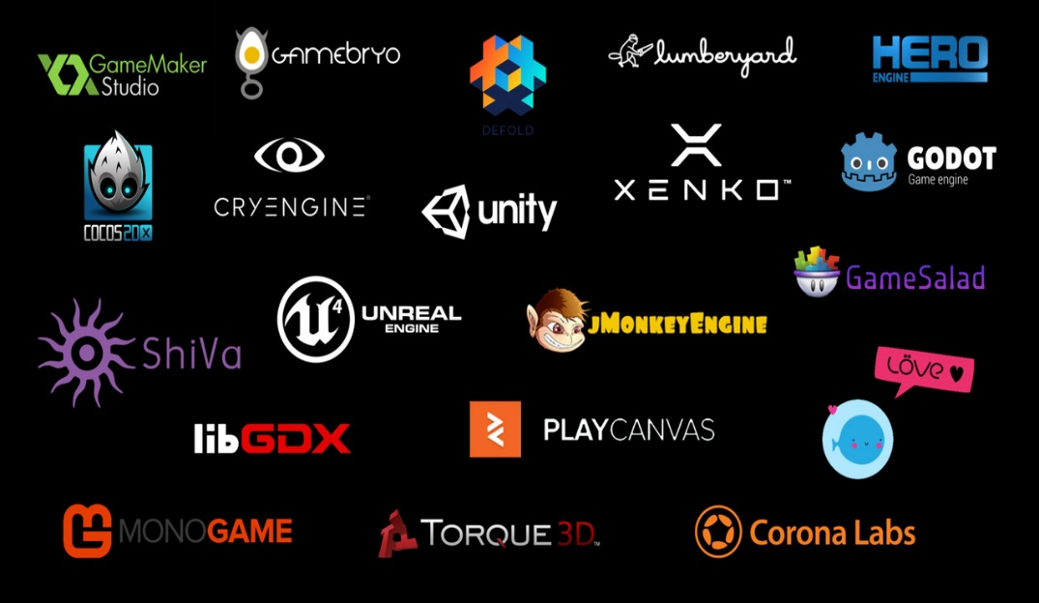
Game Engines
A game engine is a software framework used to build and run video games.
It provides ready-made systems so developers don’t have to build everything from scratch.
    Graphics Rendering System
    Physics Engine
    Audio System
    Scripting Support
    Cross-platform support
    Asset management tools
    Real-time editing

Slide 19
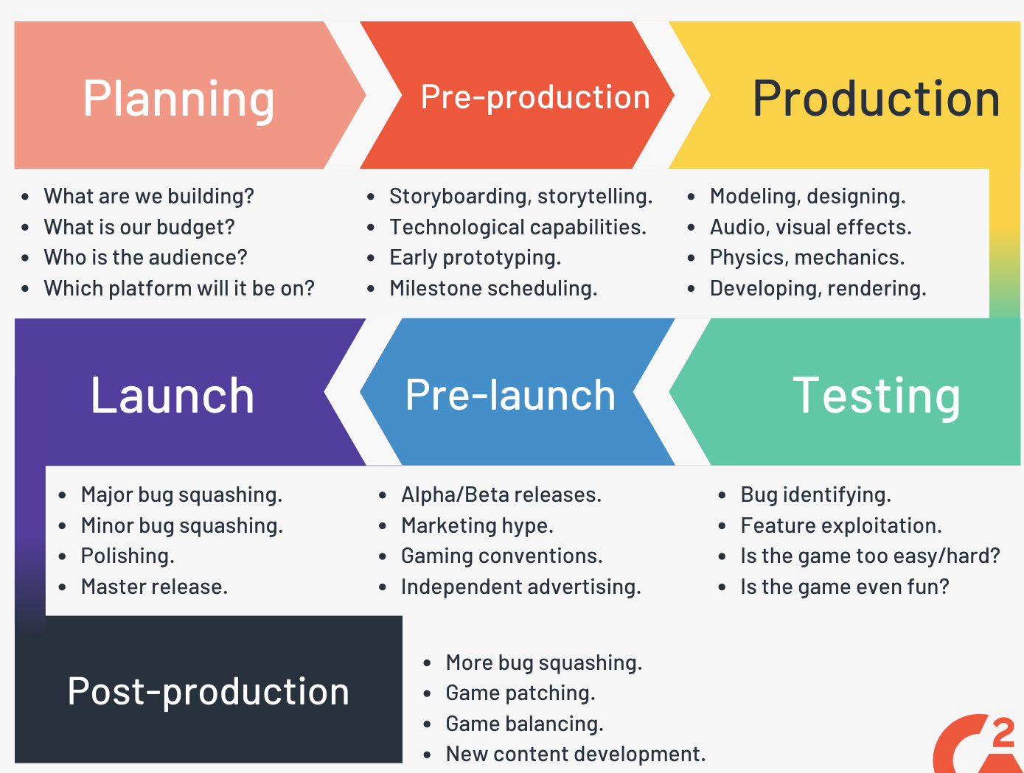
Game Development Process

Slide 20
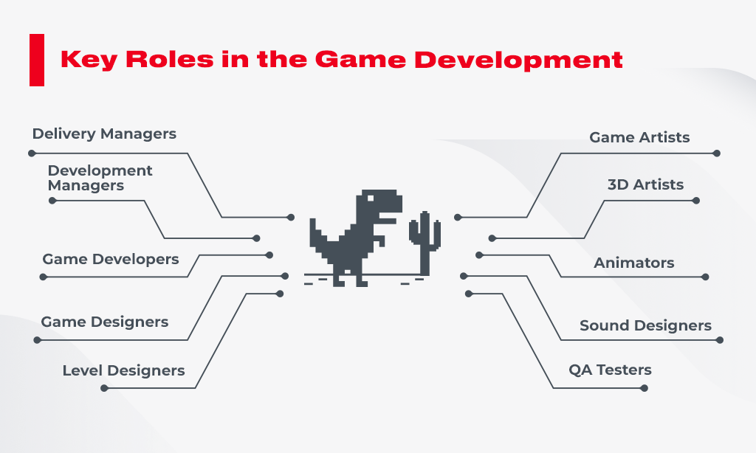
Key Roles in Game Development

